Slide 1
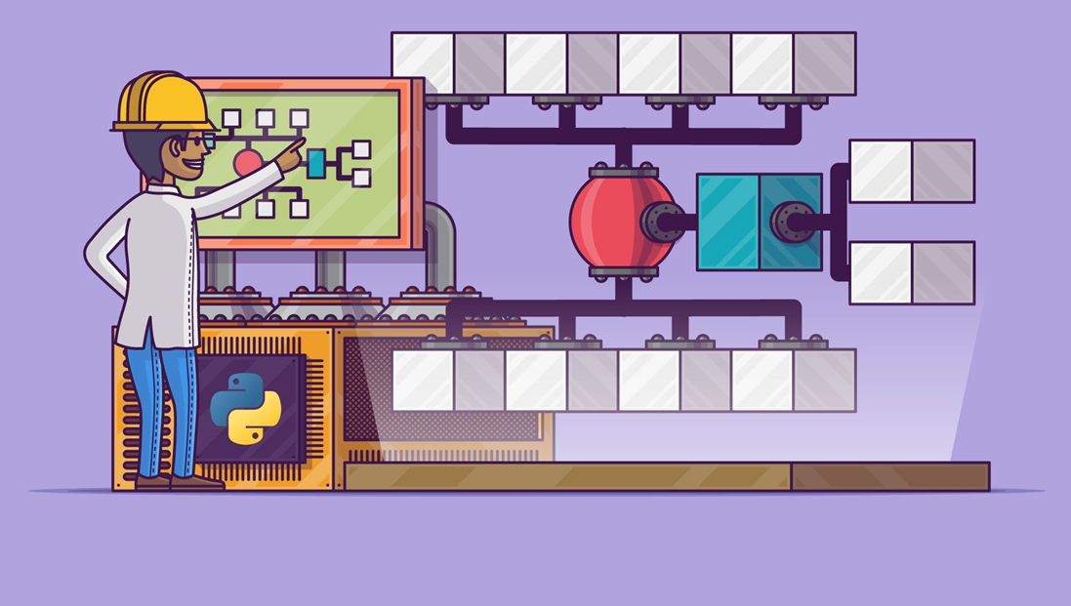
Data Structures in Python

Slide 2

Why Data Structures are needed?
When quantity of data increases in your program you need to manage it!
Imagine your Workspace at work, it is designed according to your needs.
Helps you work faster while the structure is imprinted in your mind.
Change in workspace Leads to increase in time to access your requirements.
Same goes for data, as it needs to be stored efficiently. Structure results in
better and faster access and modification is easier

Slide 3
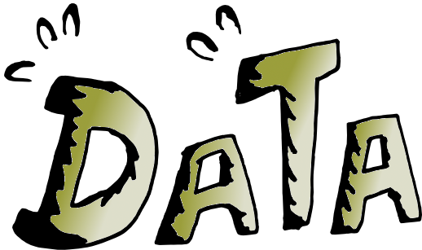


Data Structures
Data structures is simply Data with structure added.
Each data structure provides a particular way of organizing data so it can be accessed efficiently, depending on your use case.
Data Structures allows you to organize your data in such a way that enables you to store collections of data, relate them and perform operations on them accordingly.

Slide 4
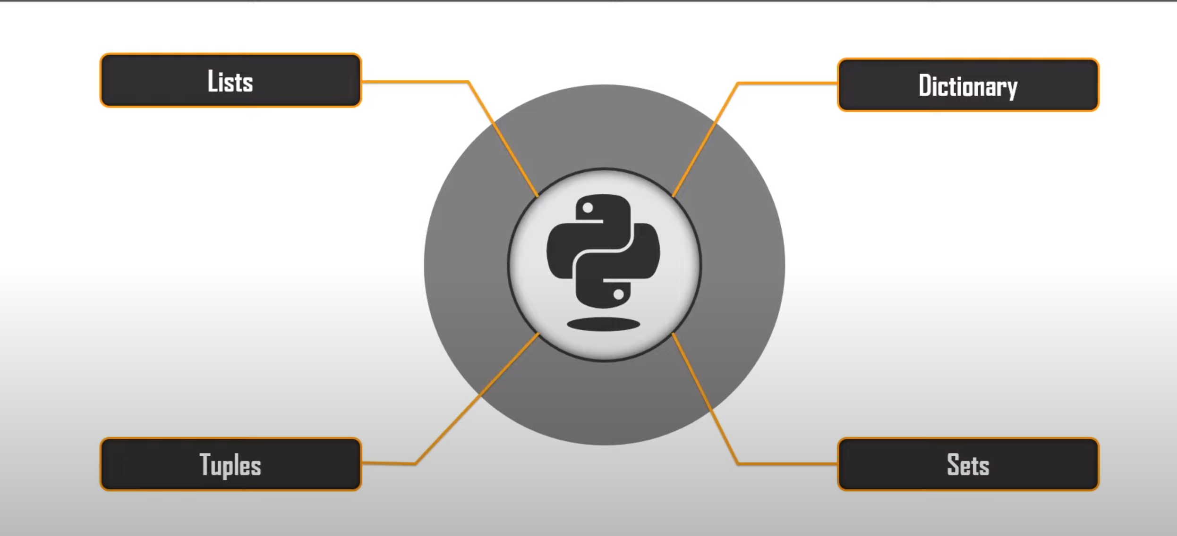
Types of Data Structures
Used to store sequential data
Mutable

Slide 5
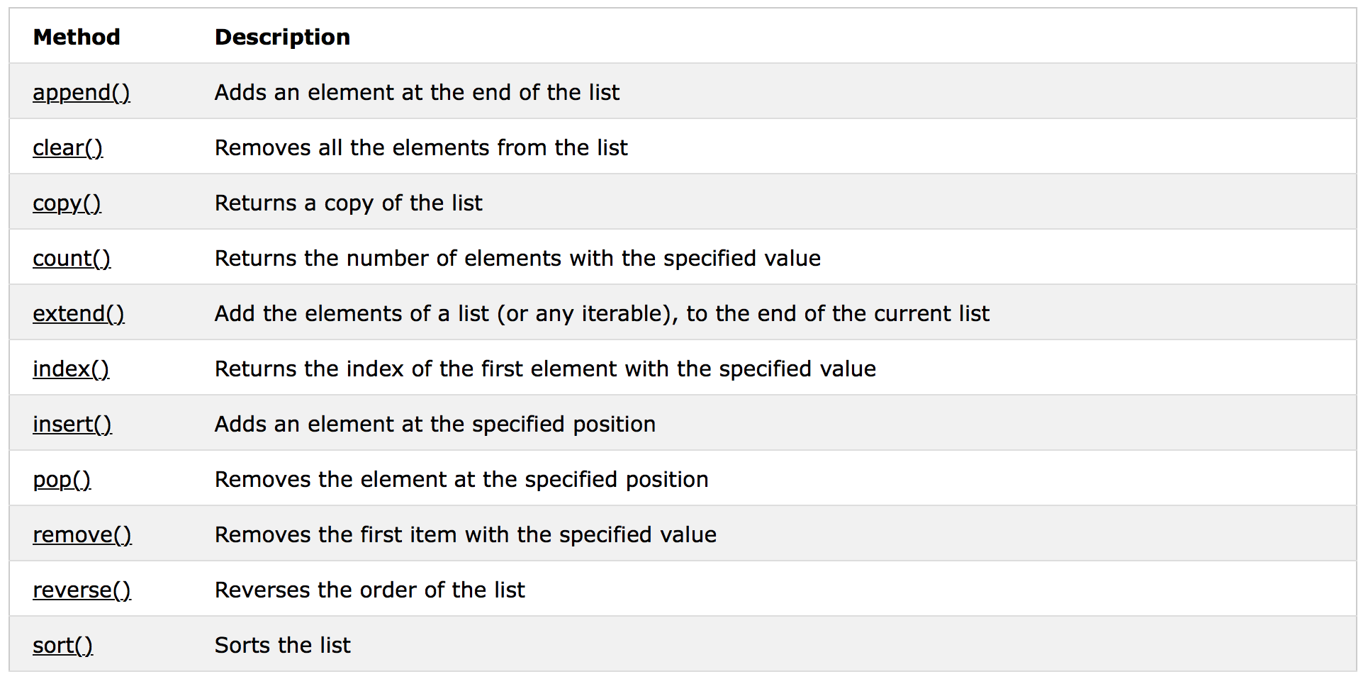
List Methods

Slide 6
Types of Data Structures
Used to store sequential data
Mutable
Used to store sequential data
Immutable
Faster
Lest memory usage

Slide 7
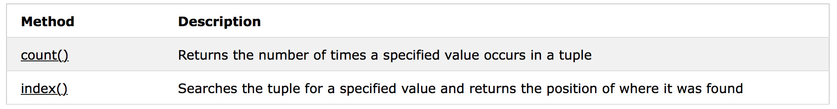
Tuple Methods

Slide 8
Types of Data Structures
Used to store sequential data
Mutable
Mutable
Key-Value Data structure
Used to store sequential data
Immutable
Faster
Lest memory usage

Slide 9
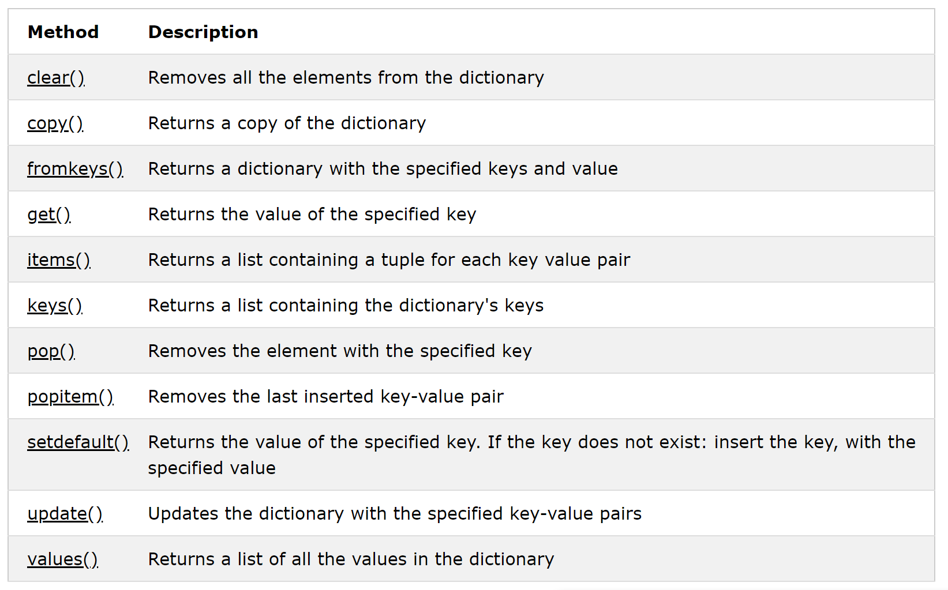
Dictionary Methods

